Slide 1

Topic: Lock – 1&2
Lecture: Dr. Zhao Jie
Date: 04/01&06/2026

Slide 2
Reading Assignment
Chapters 28

Slide 3
Agenda
Mutex lock
Single variable flag lock
Double variable flag lock

Slide 4
The motivation
Concurrency may raise issues like the race condition.
To prevent running the process from race condition, the solution to the race condition is:
Finding out the critical section
Mutual exclusively running the process
The lock is one option to solve the race condition

Slide 5
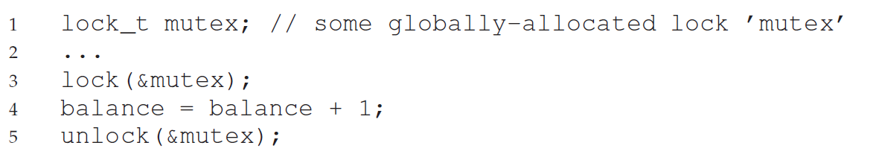

Basic idea of the lock
POSIX threads code
Notes:
In daily life, locks protect our property, allowing us to store assets in a room and use a lock to prevent others from accessing them. If the lock is used in the program and there is no such room, however, we can use a lock as a flag variable to allow only one process to access the critical section at a given time.

Slide 6
Criteria to the lock
Mutual exclusion
It prevents multiple threads from entering a critical section.
Fairness
Each thread has a chance to enter the critical section. In other words, there is no starvation.
Performance
Single thread case
Multi-thread case
Multi-CPU case

Slide 7
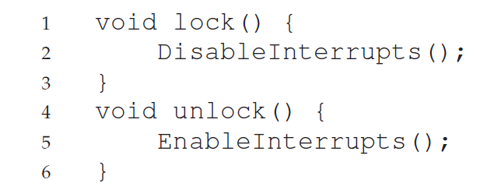
Controlling Interrupts
Implementation - hardware
Performance (Cons)
Allows any calling thread to perform a privileged operation. If a malware allows.
Not multiprocessors if multi-CPUs
Inefficient. No upper-bound how long the interruption is disabled.

Slide 8
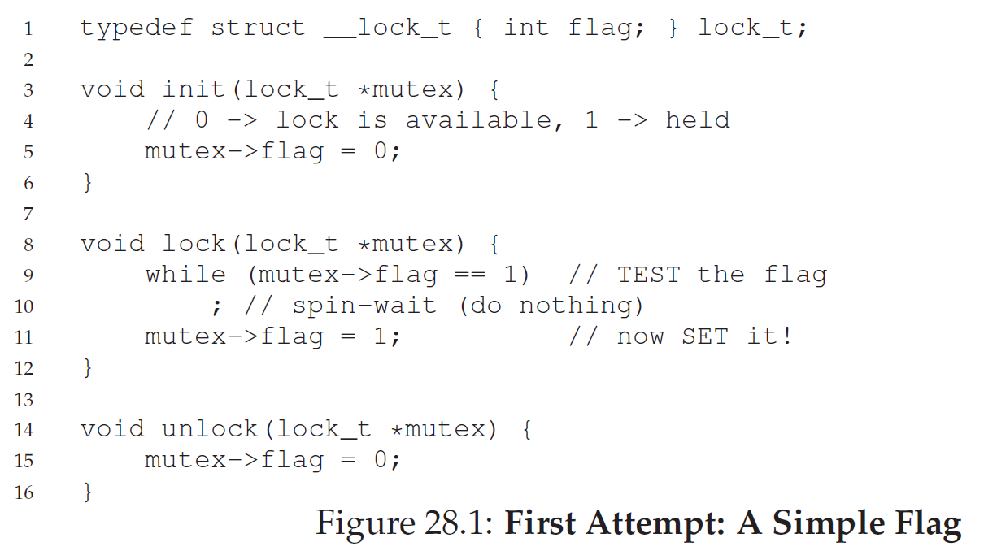
Single variable lock
Implementation
Performance
Spin-waiting: endlessly check the value of the flag
Notes:
In a computer, locking and unlocking are not human actions, but rather binary states: 0 – unlock and 1 - lock. Actually, the lock is implemented using an endless while loop, known as a spin-wait.
Discuss the endless while loop.

Slide 9
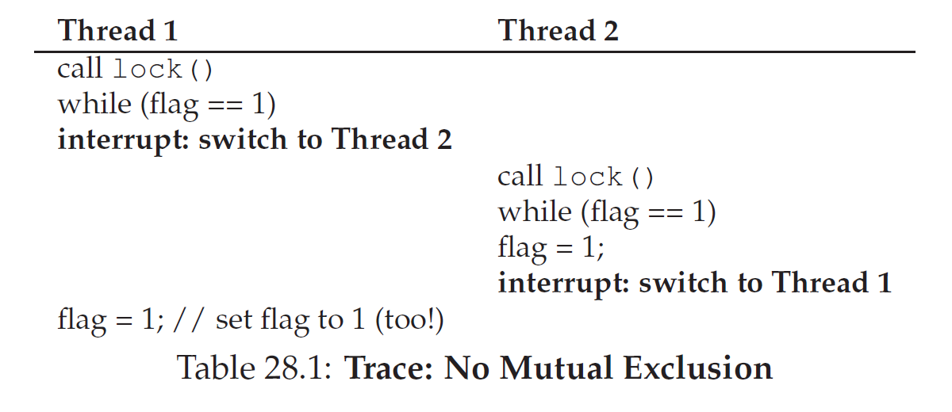
Performance of the single variable lock
Do you think the single variable lock is a good idea?
Notes:
In the single variable lock, the lock test at first and the lock set at second may cause an interruption and destroy the atomic execution. Therefore, when the lock status is tested, we must check whether the other process uses the lock.

Slide 10
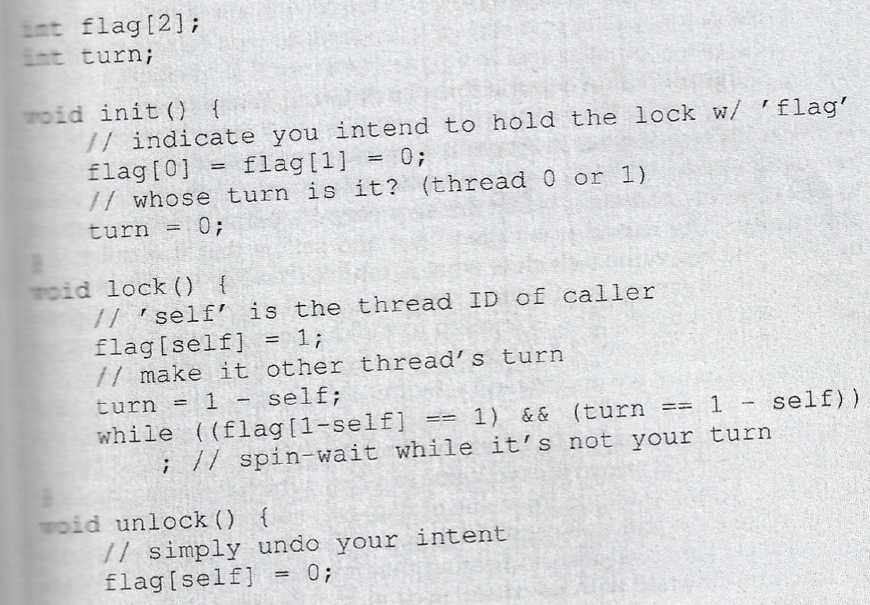
Peterson’s algorithm
"flag" is a boolean array where each element indicates whether a process intends to enter the critical section.
"turn" is an integer variable that specifies which process's turn it is to enter the critical section.
Notes:
Compared with a single variable lock, Peterson’s algorithm locks the door first and then checks if the other process has used CPU resources or not. If the other process uses the CPU resource, the calling process will spin wait.

Slide 11
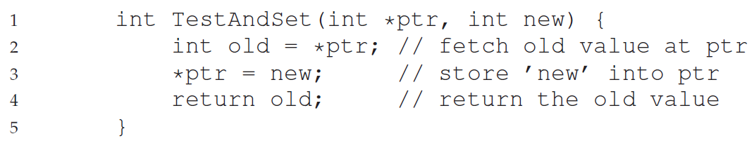
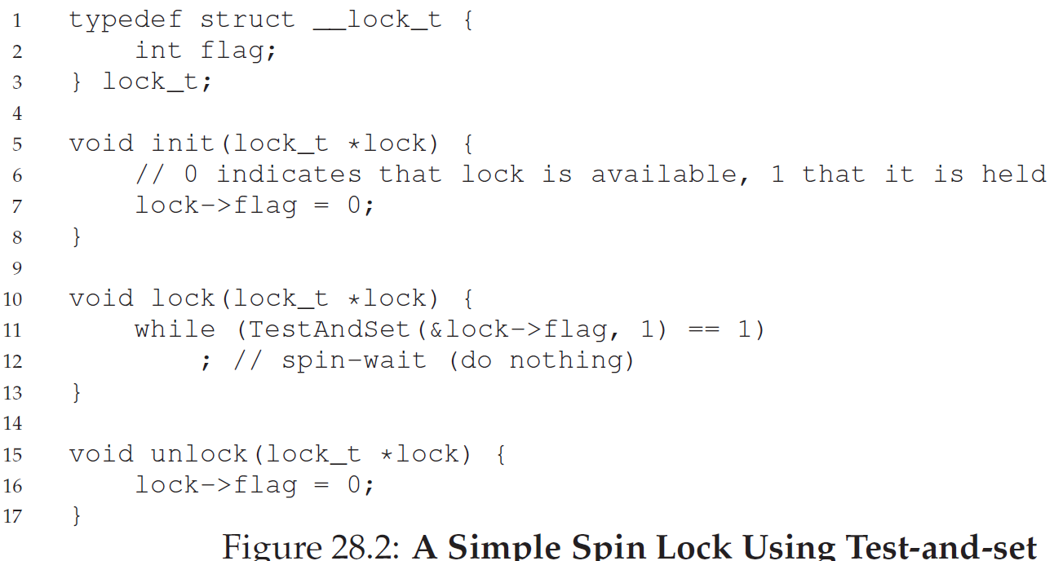
Test and set lock - 1
Implementation(hardware)
Notes:
In the test and set function, the lock flag is incremented by 1, and then the test is returned. Calling a function within the lock function is a way to make both the test and set operations concurrent.
Discuss 1). Function inputs and outputs, 2). Different outputs occur when the lock is set to 0, and when it is set to 1.
Comments: it is unnecessary to update the lock when it is 1; Thus, the extra cost occurs.

Slide 12
Test and set lock - 2
Explanation
Atomic: sequence of operations
The “test”: the old value (which is what is returned)
The “setting”: the memory location to a new value
spin lock, not spin-wait
Evaluation
Mutually exclusive
Not fairness
Painful for Single CPU, but effective for multi-CPU

Slide 13
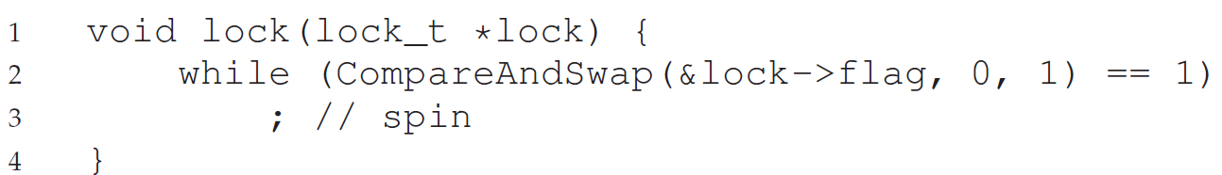
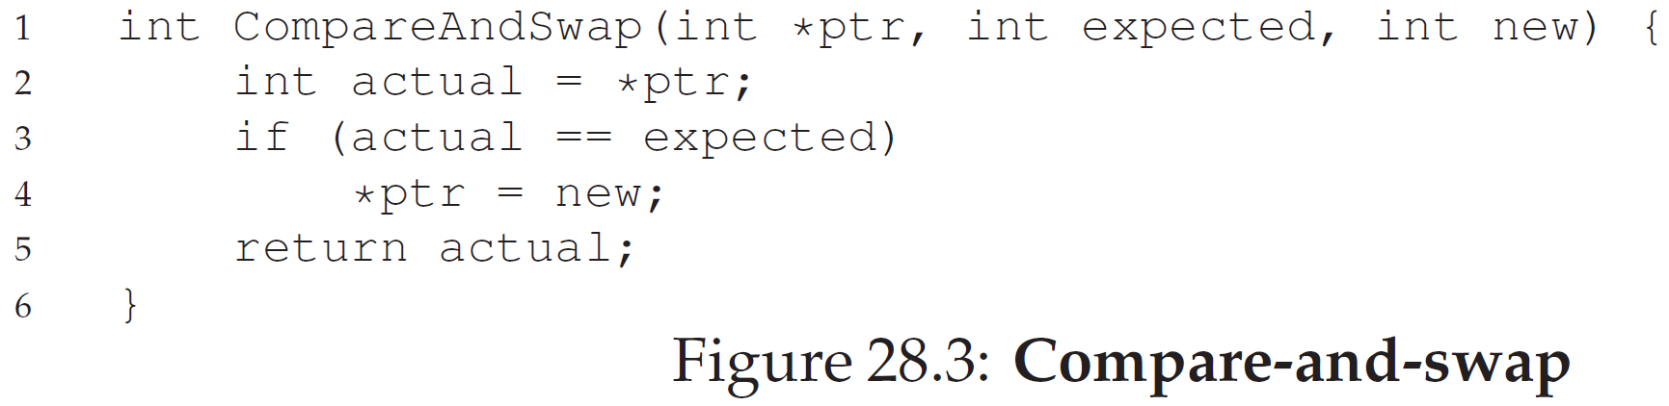
Compare and swap
Basic idea
Test if ptr is equal to expect
If so, ptr is pointed to the new value
If not, do nothing
Notes:
This code guarantees that only the caller can use the lock if the caller gets the key(*lock = 0). Then, test if the actual is equal to the expected to make an efficient spin wait.
Comments: to solve the issue from test and set, the “expect” is added to make the lock updated only when the lock is 0.

Slide 14
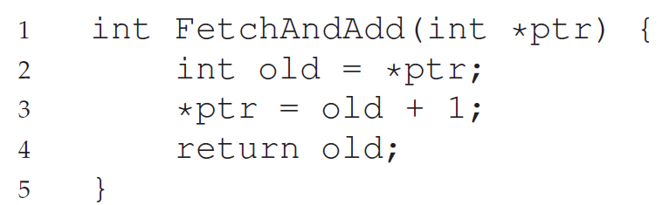
Fetch and add - 1
Basic idea
Test if myturn is equal to the system ticket
If so, ptr is pointed to the following ready thread, but returns the current thread
spin waits.

Slide 15
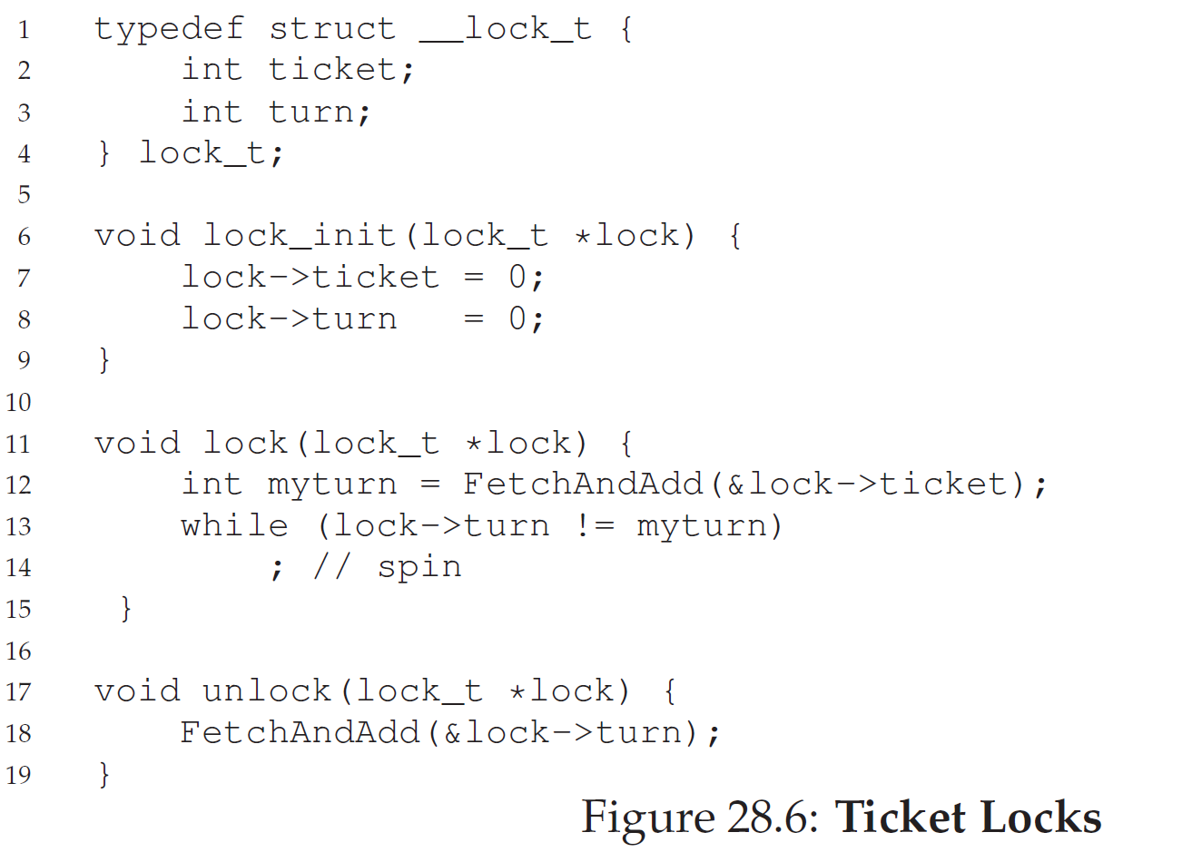
Fetch and add - 2
Performance
Optimized when at least three threads running concurrently
Notes:
Comments: Two flags can handle multi-threaded race conditions. So, the lock will be larger than 1. To make the turn has a chance to be equal to lock, the turn will be larger than 1 when the unlock function is called.

Slide 16
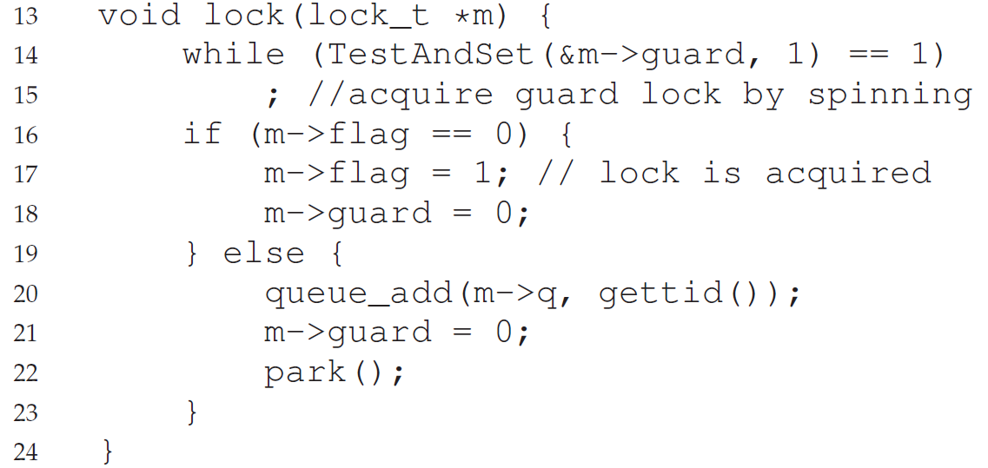
Using queue - 1
Basic idea
Uses the Test and Set
Uses the queue to track the next lock, avoiding starvation
In lock( ), if a thread cannot get a lock, the thread is added to the queues by linking its pid to the queue and make its turn ready.

Slide 17
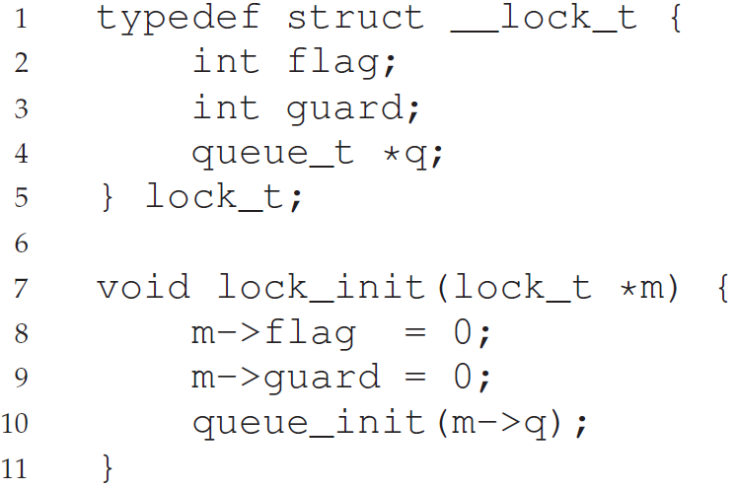
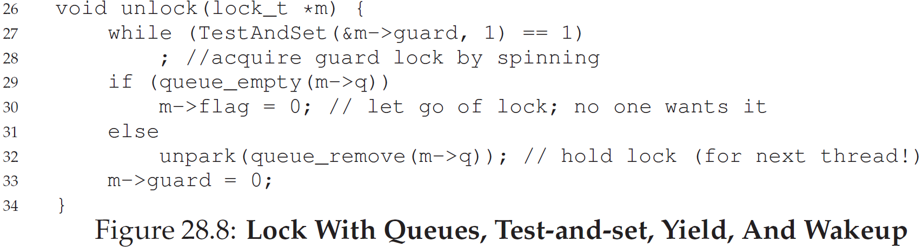
Using queue - 2

Slide 18
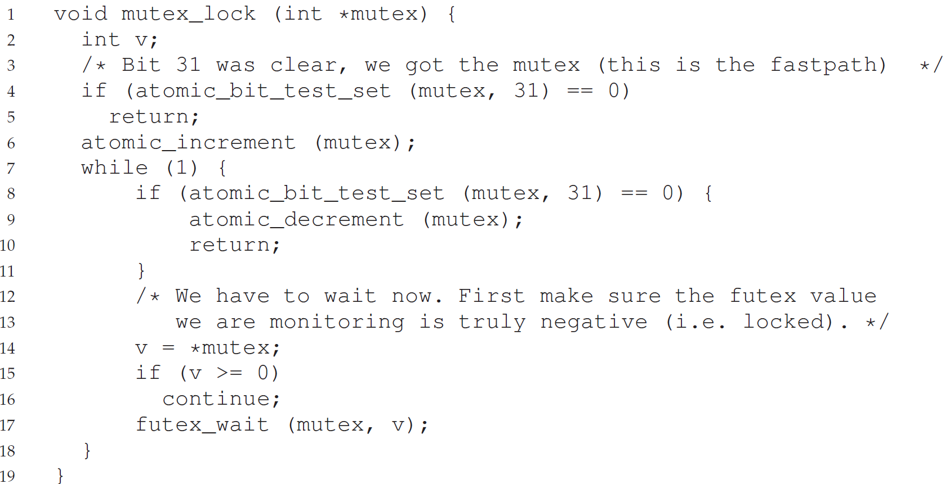
Using futex in Linux - 1

Slide 19
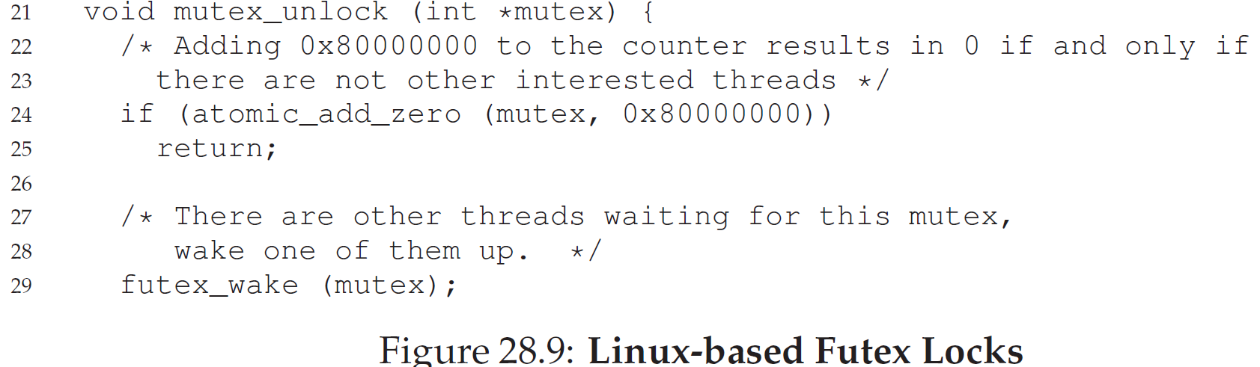
Using futex in Linux - 2
Performance
In the lock, when the mutex value in the caller is negative, the caller sleeps.
It is efficient to use the caller sleeping instead of spin wait.
The caller will be waken in the unlock

